Slide 1
PDF Indexing
Or How to Enable Search for 16,000 documents
Jason Johns
Lead Developer, DegreeData

Slide 2
About Me
Native Mainer
Full stack web dev
Java & Python
Angular 1.x or React

Slide 3
A Bit of Background
DegreeData started in 2010 with the goal to become the Internet Archive of college catalogs by copying PDF documents and mirroring web catalogs.
Primary usage is for university registrar’s to easily access specific institution/year catalogs to facilitate incoming student transfer equivalency credits.
To do that, we have an internal data entry application that saves data to a database for which an external website queries via REST API.
We have ~25,000 catalogs across 4000 institutions in the US covering years from 2007 to 2016

Slide 4
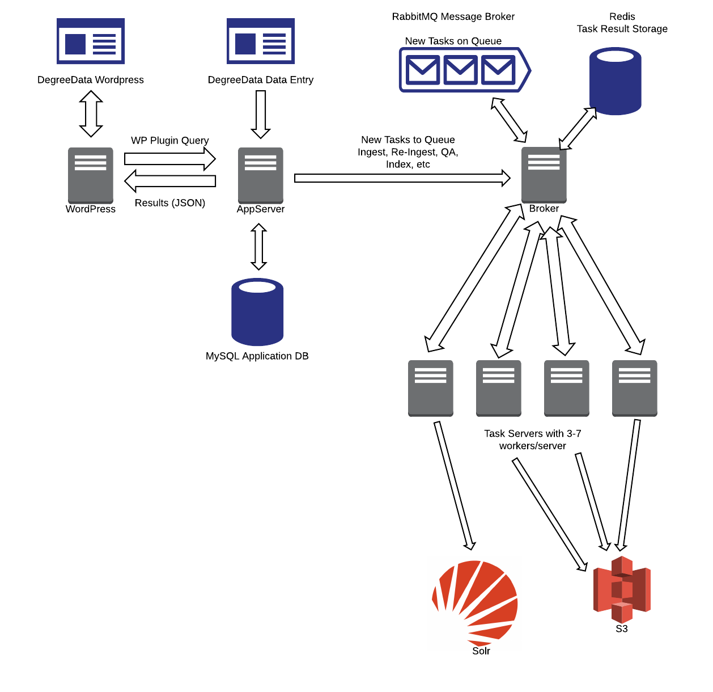
Initial Infrastructure
Python/Django
MySQL & Redis
RabbitMQ
Celery
Notes:
Describe basic layout of infrastructure and reasons for these design decisions

Slide 5
Workflow - Internal
For each state ordered in institution density starting with CA, NY & MA,
Specifically trained contractors enter, among other information, catalog year, type and URL into the internal application.
DB create triggers Celery task to ingest catalog based on media type (Web, PDF) and store in media-specific S3 bucket
After ingestion completes, contractor manually checks the results on S3 and flags based on catalog quality.

Slide 6
Workflow - Users
Public Wordpress site has a plugin for the REST API
Users enter in data about catalog (Institution Name, State, Degree Type) and API returns any matches.
User finds catalog year required and new tab opens with the web viewer template

Slide 7
Internal Catalog Search Requirements
There had been a previous indexing project attempted ~3 years ago and failed because of significant slowdown in the whole catalog ingestion process. Therefore, the following were identified as primary considerations:
Pluggable into Celery task sequence
This was easily done using task callbacks
High quality PDF processing
PDFMiner - Github
Apache PDFBox
Solr server handling mass bulk inserts
Any re-index of entire catalog for new Solr schema should take less than a weekend.
Notes:
Using task callbacks, we were able to sequence ingestion task and indexing so that when the ingestion task completed, the index would start.
Handling PDFs in code will always be problematical because of a very lax set of standards. We decided to go with PDFMiner first because its written in Python (lowering maintenance demands) and has been around for a while. PDFBox was seriously considered, but as I’m the only person in the company that knows Java combined with a more complex build and deploy process tilted the balance towards PDFMiner
A AWS T2.Large server was configured for Solr to handle bulk inserts. Mass indexing is very burstable, which fits that instance class

Slide 8
... but wait!
Quality control has been a longtime issue. Due to original infrastructure issues, the actual state of the database records did not always match what we actually had in S3.
A content check was required to
Reconcile the database records with S3
Attempt to open PDF and iterate over the pages
Save results to database table
Notes:
Previous ingestion infrastructure was very touchy and fragile. It also didn’t include any kind of feedback to the employee of whether ingestion was successful or there was an issue. The only way any issues could be discovered was by manually checking the catalog in the web app using the Users workflow described earlier.
We found at least 1000 documents that the database said we had and were valid, but were in actuality missing. 800 of those URLs were 404’d
~100 “PDFs” were actual Web pages mis-labeled
440 PDF files were unable to be opened

Slide 9
What we found
1034 records were not found on S3, while flagged as good quality to be served to users.
~800 had 404 status for the URL
Rest were re-ingested
~100 mis-file issues where web catalog was mislabeled as PDF
~280 PDFs were unable to be opened by PDFMiner due to empty password encryption
~500 PDFs were unable to be processed due to long standing bug
14,000 documents passed the content check.
Notes:
When creating a PDF, the author can set the password to be an empty string. This will encrypt the document using the empty string as a key. Most viewers, including browsers and desktop applications, can handle this case and display the document without bothering the user. PDFMiner cannot handle the issue whereas PDFBox can.

Slide 10
Celery Worker Configuration
3 C4.Large instances were created on EC2, each with six worker process.
Celery daemon service was configured using celeryd
Basic Celery daemon configuration with --maxtasksperchild=1 and -Ofair set in the options. Without this, the worker process would eventually stop picking up new tasks and lie idle until restart.

Slide 11
Full Speed Ahead
Overall indexing of ~14000 catalogs took 3.5 days to complete with each worker averaging one catalog every five minutes.
This was accomplished despite
Some server downtime was necessary to fine-tune daemon configuration on previous slide.
Having to instantiate a Large class EC2 instance for Solr to avoid OutOfMemoryExceptions during bulk inserts

Slide 12
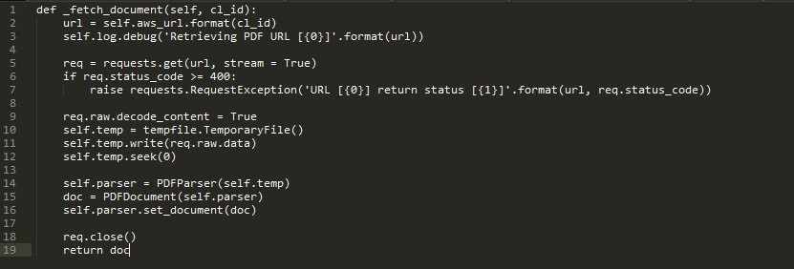
Celery Task - Retrieve Document
Notes:
Retrieve the document, create an in-memory temorary file and create the PDFMiner PDFDocument

Slide 13
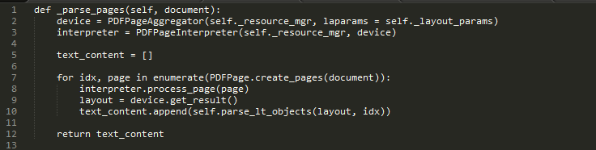
Celery Task - Parse Pages

Slide 14
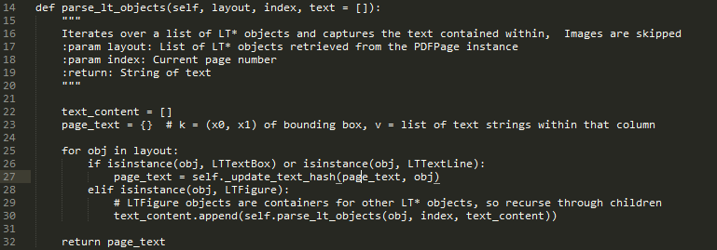
Celery task - Parse LT* Objects from Page
Notes:
The goal here is to construct a dict of the page’s text using a tuple of the XY coordinates of the line item’s bounding box mapped to a list of strings in that column.

Slide 15
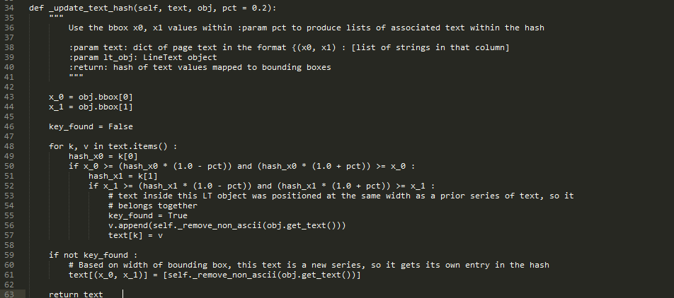
Celery Task - Create Hash from LT* objects

Slide 16
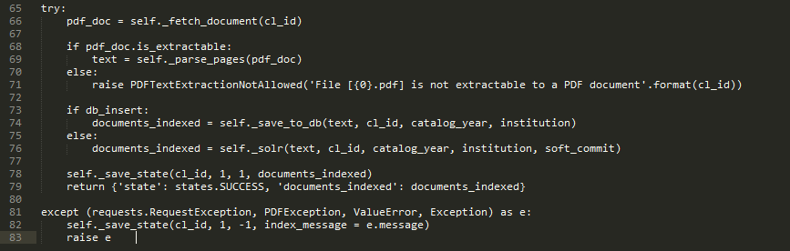
Celery Task - Run
Notes:
The actual run() method of the celery task. It fetches the document from S3, creates an in-memory object of the file, extracts the text, saves state to DB and uploads to Solr

Slide 17
Future Modifications
PDFMiner is a decent library and allowed us to complete this project in two weeks, including the time spent indexing. However, it has two major issues which prevent it from being an unqualified success.
Work is underway on implementing similar solution with Apache’s PDFBox and integrating it with Celery. Initial proof-of-concept testing has been successful with catalogs unparseable by PDFMiner

Slide 18
Upcoming Work
Integrate PDF search with viewer template
Incorporate code and lessons learned to index 6000+ Web catalogs consisting of ~10M pages
Integrate Web search with template... big challenge.
Re-evaluate Solr schema for more nuanced search as appropriate.
Return location in document where match occurs
Full page search and analysis for content extraction

